Slide 1
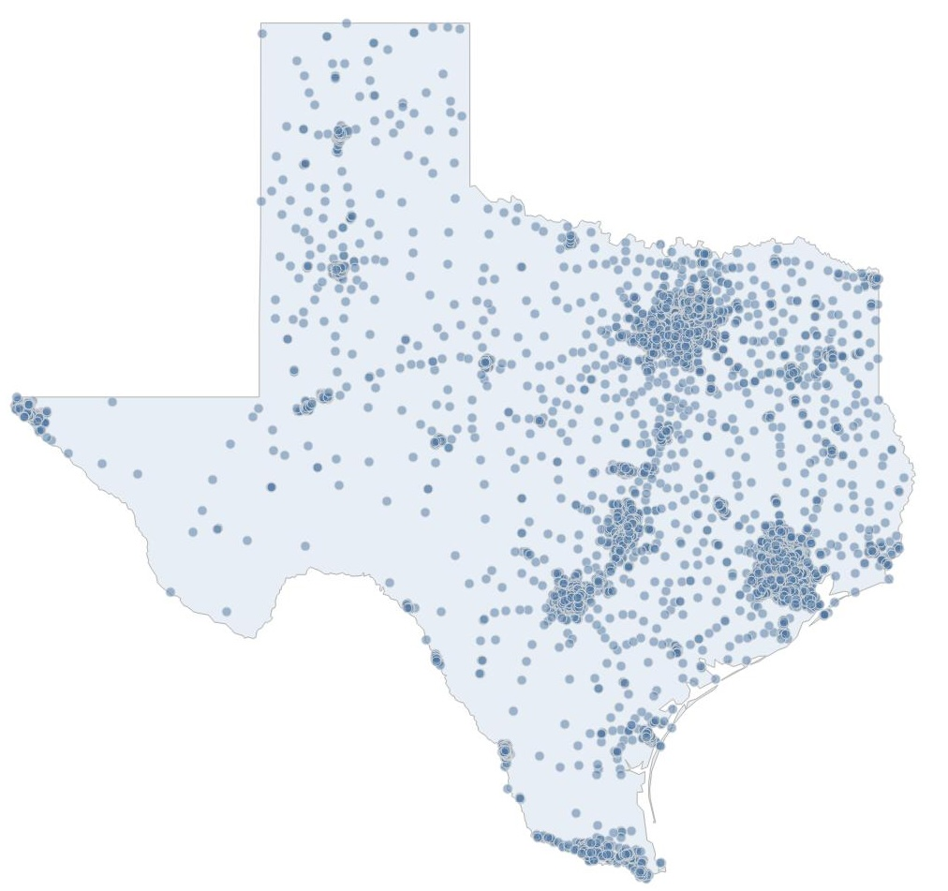
2024-2025 STAAR Analysis
Measures how well Texas public school students have learned the Texas Essential curriculum standards
Identifying student characteristics associated with Did Not Meet Grade Level outcomes on elementary State of Texas Assessments of Academic Readiness Assessments (STAAR)
Analysis was done using Python and Excel
Texas elementary school locations.
Map created by the author in Tableau
using NCES school-geocode data (NCES, n.d.).
(National Center for Education Statistics [NCES], n.d.)

Slide 2
Problem Statement Part 1
Grades 3–5 Mathematics and RLA; Grade 5 Science

Slide 3
Problem Statement Part 1
Grades 3–5 Mathematics and RLA; Grade 5 Science
4,965 unique schools (Tested 1,149,932 students in RLA)
Source: Texas Education Agency (2025).
Source: Texas Education Agency (2025).

Slide 4
Problem Statement Part 1
Grades 3–5 Mathematics and RLA; Grade 5 Science
Early gaps can widen over time
4,965 unique schools (Tested 1,149,932 students in RLA)
Source: Texas Education Agency (2025).
Source: Texas Education Agency (2025).

Slide 5
Problem Statement Part 1
Grades 3–5 Mathematics and RLA; Grade 5 Science
Early gaps can widen over time
Identification in struggles improves education pipeline
4,965 unique schools (Tested 1,149,932 students in RLA)
Source: Texas Education Agency (2025).
Source: Texas Education Agency (2025).

Slide 6
Problem Statement Part 2
Many students perform well, but some Do Not Meet Grade Level standards
STAAR reports four performance levels
Masters Grade Level
Meets Grade Level
Approaches Grade Level
Did Not Meet Grade level, or Below-Grade-Level

Slide 7
Texas STAAR Testing by Subject
Did not meet
Approaches
Only grade 5 tested in Science, so less students
35.2% Did Not Meet Standards in Science and 28.6% in Math
Meets
Masters
327,155 281,982 286,103 250,393
249,786 271,327 335,090 293,729
134,931 130,962 70,160 47,741
Source: Texas Education Agency (2025).
Source: Texas Education Agency (2025).
Source: Texas Education Agency (2025).

Slide 8
STAAR Performance Grade 3
Did not meet
Approaches
28.9% Did Not Meet standards in math and 23% in RLA
Meets
Masters
n = 110,729 n = 95,375 n = 101,968 n = 74,525
n = 88,078 n = 97,574 n = 110,036 n = 87,213
Source: Texas Education Agency (2025).
Source: Texas Education Agency (2025).

Slide 9
STAAR Performance Grade 4
Did not meet
Approaches
30.6% Did Not Meet standards in math and 19.4% in RLA
Meets
Masters
n = 116,772 n = 85,572 n = 87,910 n = 91,102
n = 74,205 n = 101,078 n = 116,517 n = 91,186
Source: Texas Education Agency (2025).
Source: Texas Education Agency (2025).

Slide 10
STAAR Performance Grade 5
Did not meet
Approaches
35.2% Did Not Meet standards in Science and 26.1 Did Not Meet in Math
Only 12.4% Mastered Science
Meets
Masters
99,654 101,035 96,225 84,766
87,503 72,675 108,537 115,330
134,931 130,962 70,160 47,741
Source: Texas Education Agency (2025).
Source: Texas Education Agency (2025).
Source: Texas Education Agency (2025).

Slide 11
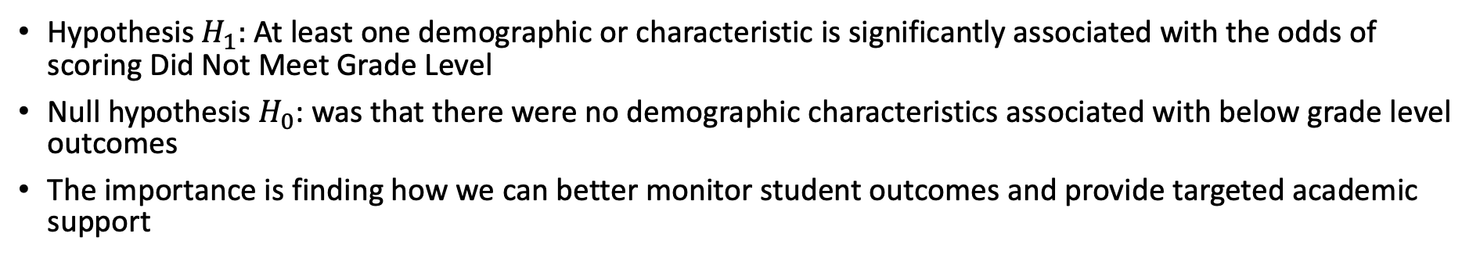
Hypothesis: Student Demographics and Characteristics Are Associated With Below-Grade-Level Outcomes
Hypothesis $H_{1}:$ At least one demographic or characteristic is significantly associated with the odds of scoring Did Not Meet Grade Level
Null hypothesis $H_{0}$: was that there were no demographic characteristics associated with below grade level outcomes
The importance is finding how we can better monitor student outcomes and provide targeted academic support
Demographics
Race
Characteristics
Economically Disadvantaged
Gender
At Risk
Current / Former Special Ed
Current EB/EL
Migrant
Gifted/Talented

Slide 12
Creating an Analysis-Ready Dataset
Raw TEA data were not immediately analysis-ready
TEA campus files required six preparation steps before statistical analysis
Preserved campus identifiers, addressed privacy codes, and created consistent outcomes across Grades 3–5
Download
Calculate
Combine
Standardize
Masking Codes
Filter

Slide 13
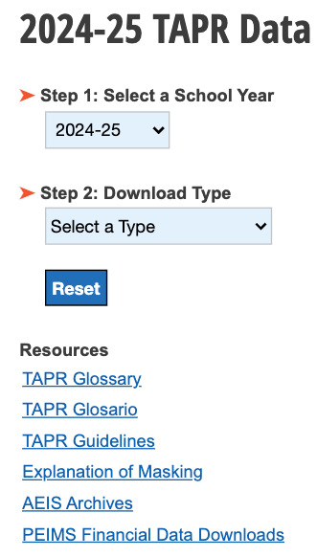
Creating an Analysis-Ready Dataset
Downloaded 2024–25 campus-level STAAR CSV files from TEA TAPR
Collected campus-level files for the required grades and subjects
Established a consistent source for the analysis
Download
Calculate
Combine
Standardize
Masking Codes
Filter
(Texas Education Agency, 2025)

Slide 14
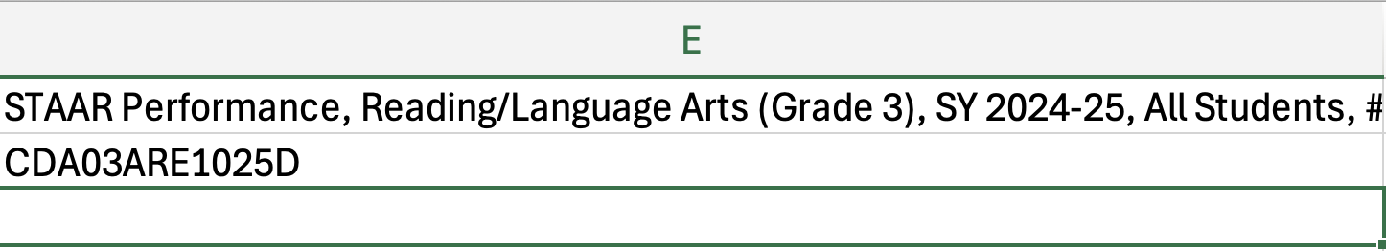
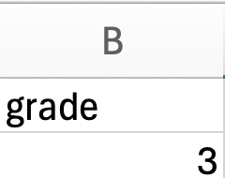
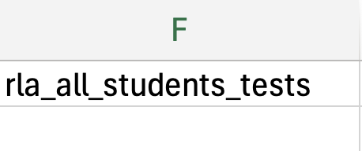
Creating an Analysis-Ready Dataset
Preserved campus IDs as nine-character text, including leading zeros in Python
Removed TEA’s secondary metadata/code row
Standardized column headings into consistent names and created grade level columns for grade 3, 4, and 5 CSV’s
Standardize
Download
Before
Calculate
Filter
Masking Codes
Combine
After
This prevented campus mismatches and made consistency across multiple files for later analysis easier

Slide 15
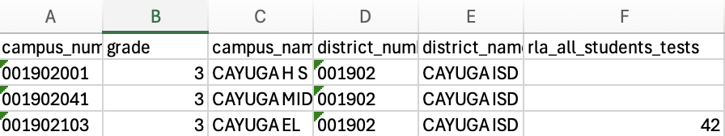
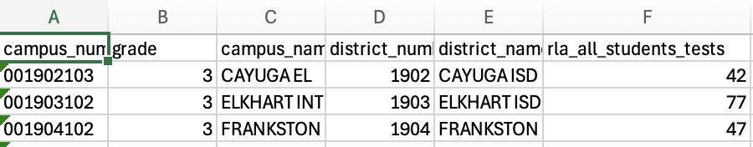
Creating an Analysis-Ready Dataset
Filtered and removed campus-grade records with no tested-student results
Grade 3, 4, and 5 files included high schools and middle schools
Before
Filter
Standardize
Masking Codes
Download
After
Calculate
Combine
This prevented non-tested campuses and only grade-level testing results

Slide 16
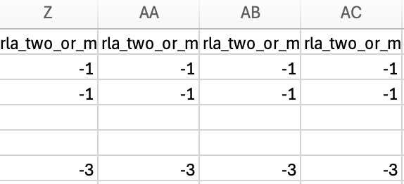
Creating an Analysis-Ready Dataset
TEA masks small-group results to protect student confidentiality and comply with the federal Family Educational Rights and Privacy Act (FERPA)
Small student groups are coded as a -1 and -3 is the next smallest group
Excluding these results prevented privacy-protection codes from being interpreted as actual negative student counts
Masking Codes
Filter
(Texas Education Agency, 2025)
TEA codes
(-1 and -3)
Converted to missing values
Excluded from calculations
Standardize
Combine
Download
Calculate

Slide 17
Creating an Analysis-Ready Dataset
Combined files in Python by placing the Grade 3, 4, and 5 records into one table which is like stacking three spreadsheets vertically
Each record kept campus, grade, and subject identifiers, allowing the grades to be analyzed together
Combine
Grade 3
Grade 4
Grade 5
Combined dataset
Masking Codes
Filter
Calculate
Standardize
Download

Slide 18
Creating an Analysis-Ready Dataset
Combined files in Python by placing the Grade 3, Grade 4, and Grade 5 records into one table which is like stacking three spreadsheets vertically
Each record kept campus, grade, and subject identifiers, allowing the grades to be analyzed together
Combine
Grade 3
Grade 4
Grade 5
Combined dataset
Masking Codes
Filter
Calculate
Standardize
Download

Slide 19
Creating an Analysis-Ready Dataset
TEA provided the Total Tested and Approaches or Above counts
Did Not Meet was calculated as the difference between those values
Total Tested
Approaches or Above
Did Not Meet
Calculate
Combine
Source: Texas Education Agency (2025).
Source: Texas Education Agency (2025).
Calculated
Masking Codes
Download
Did Not Meet vs. Approaches or Above
Filter
Standardize

Slide 20
How the Data Were Analyzed
Binomial Logistic regression
Binomial logistic regression: Compared each student group with its reference group while accounting for grade and subject
Odds ratio: Showed the direction and size of the difference in below-grade-level odds (positive or negative odds)
P-value: Indicated whether the evidence met the .05 threshold for statistical significance
A
A
A
grade and subject
Odds compared fairly
B
B
B
Odds Ratio
1.0 = no difference
> 1 = higher odds
P-value
P < 0.05 - statistically significant
P >= 0.05 - not statistically significant
< 1 = lower odds
Odds Ratio
P-value
Stronger evidence of
influenced outcome
Weaker evidence characteristic
influences below-grade-level
outcome
0.5
50% lower odds scoring below grade level
1.0
no difference in odds
2.0
100% higher odds scoring below grade level
.02
0
.05 cutoff
.10

Slide 21
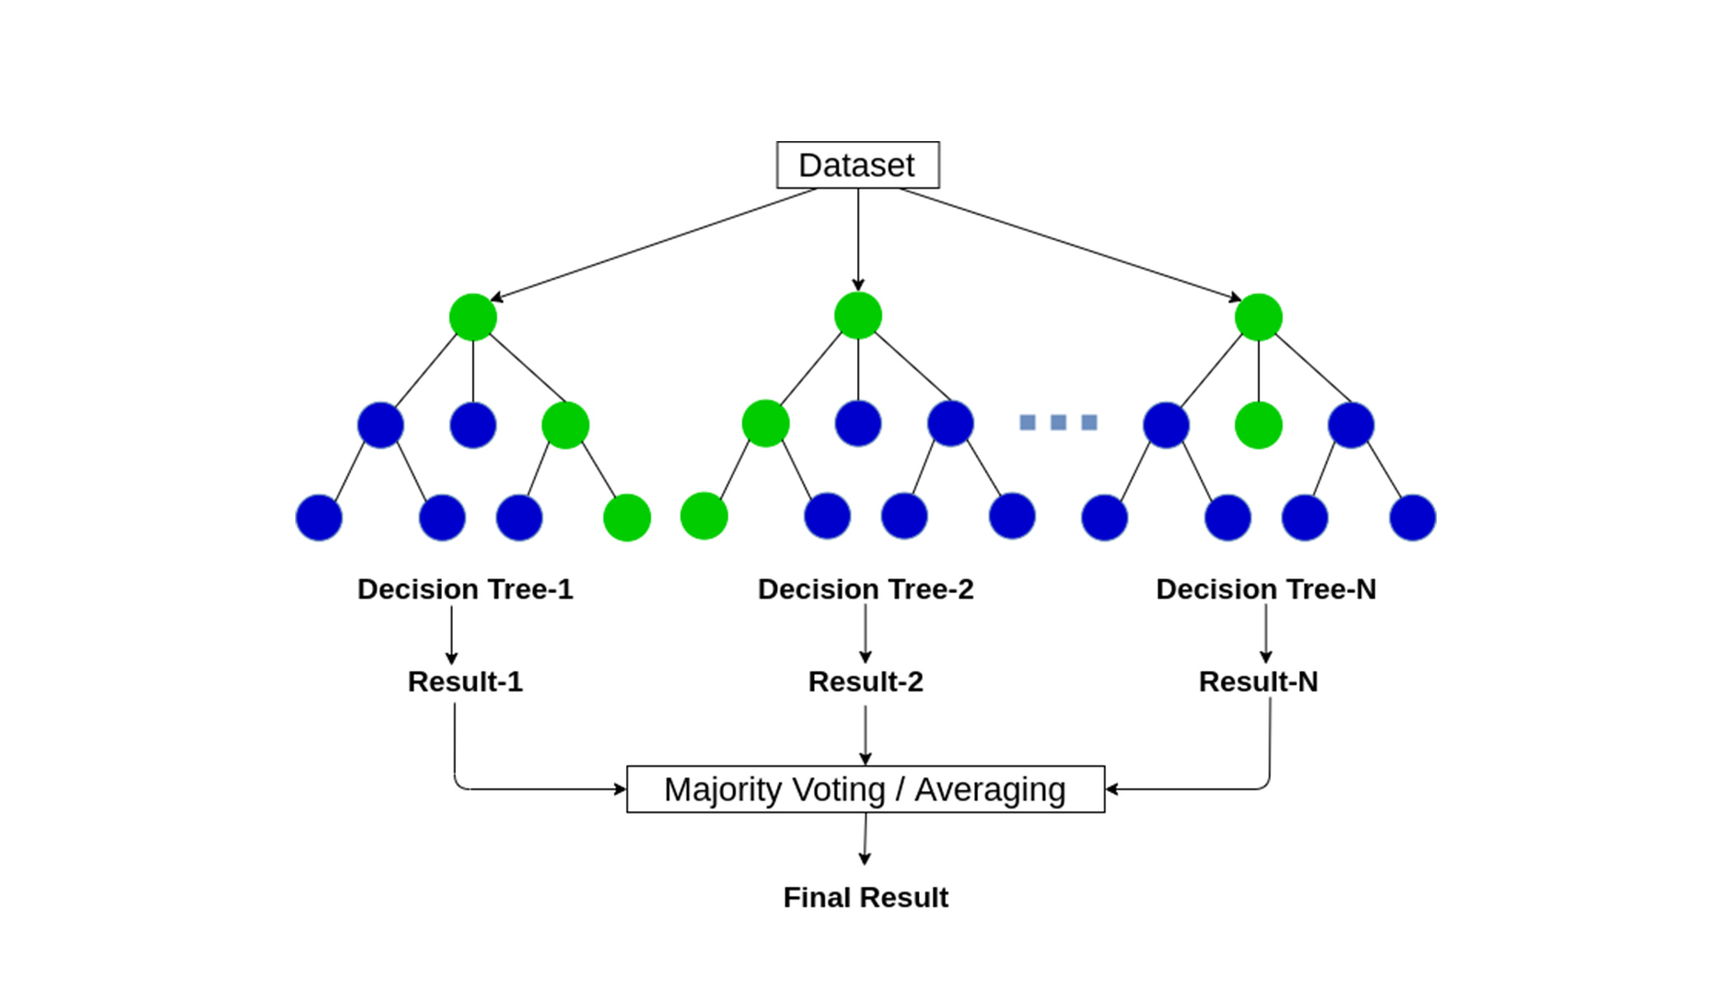
Random Forest Provided a Supporting Predictive Check
Combined many decision trees to predict below-grade-level performance
Ranked the characteristics that were most useful for prediction
On the test data, predictions were off by about 8.6 percentage points on average
The model explained approximately 49% of the variation in outcomes
Brital (2021), Random Forest Algorithm Explained
Random forest supported the regression analysis by identifying
useful predictors, but it did not establish statistical
significance or causation

Slide 22
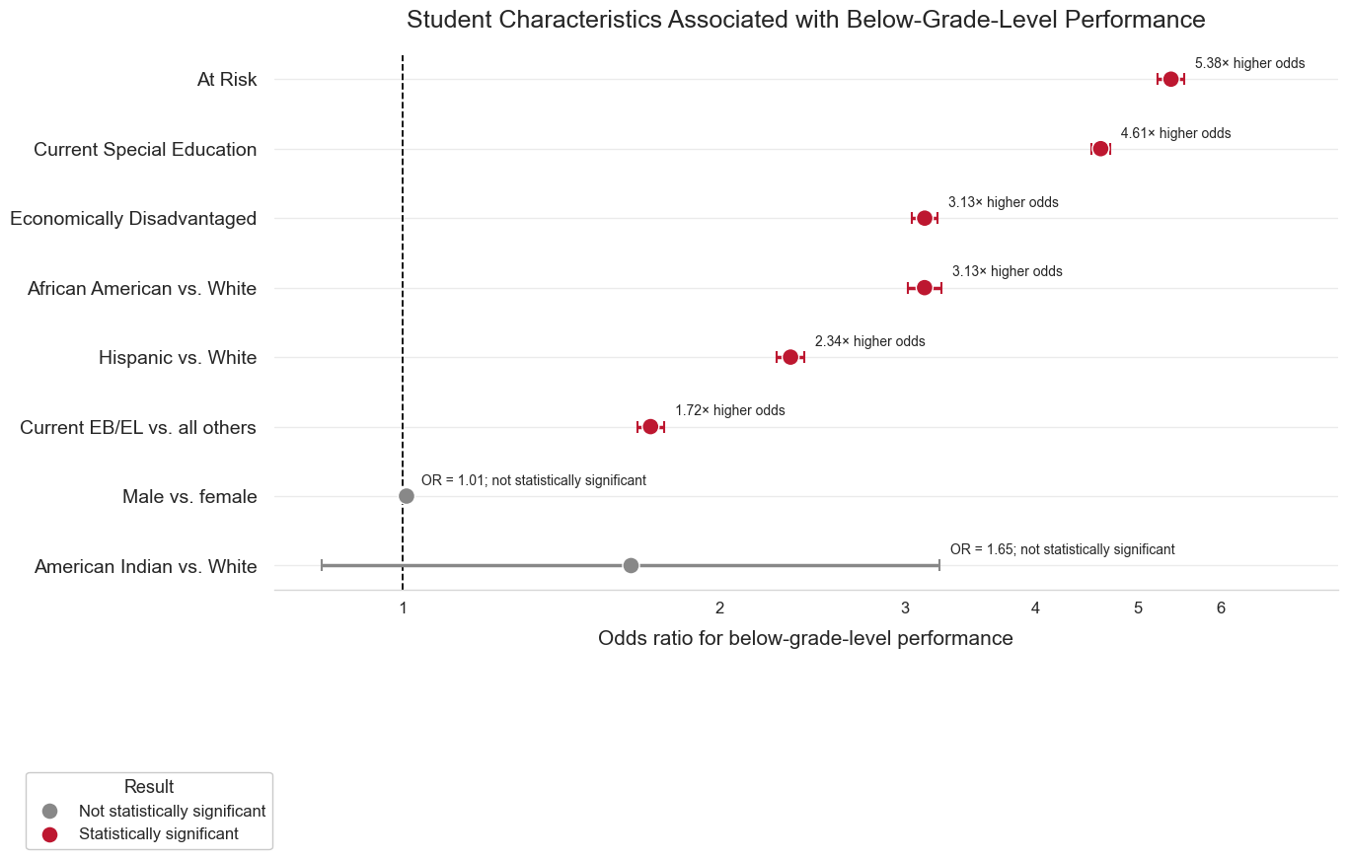
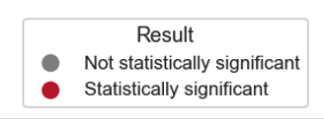
Statistical Findings
At-Risk and Current Special Education Status Had the Strongest Associations
Source: Author’s analysis of Texas Education
Agency (2025) data.

Slide 23
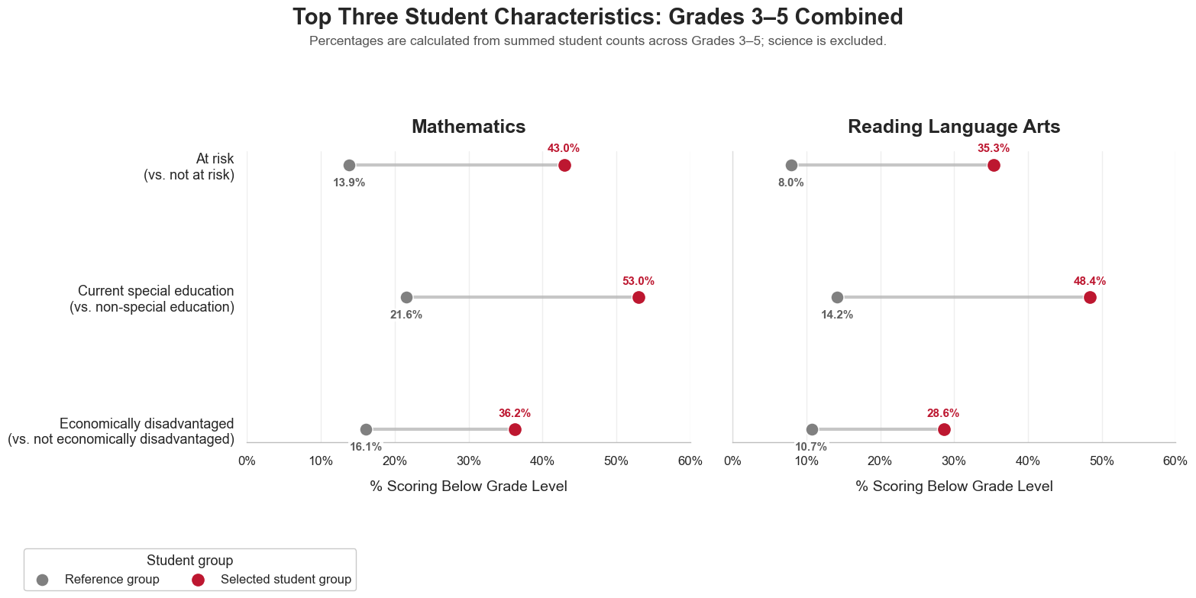

At-Risk and Special Education Groups Had the Highest Below-Grade-Level Rates
Observed statewide Math and RLA percentages, Grades 3–5 combined and weighted by students tested
Source: Author’s analysis of Texas Education
Agency (2025) data.

Slide 24
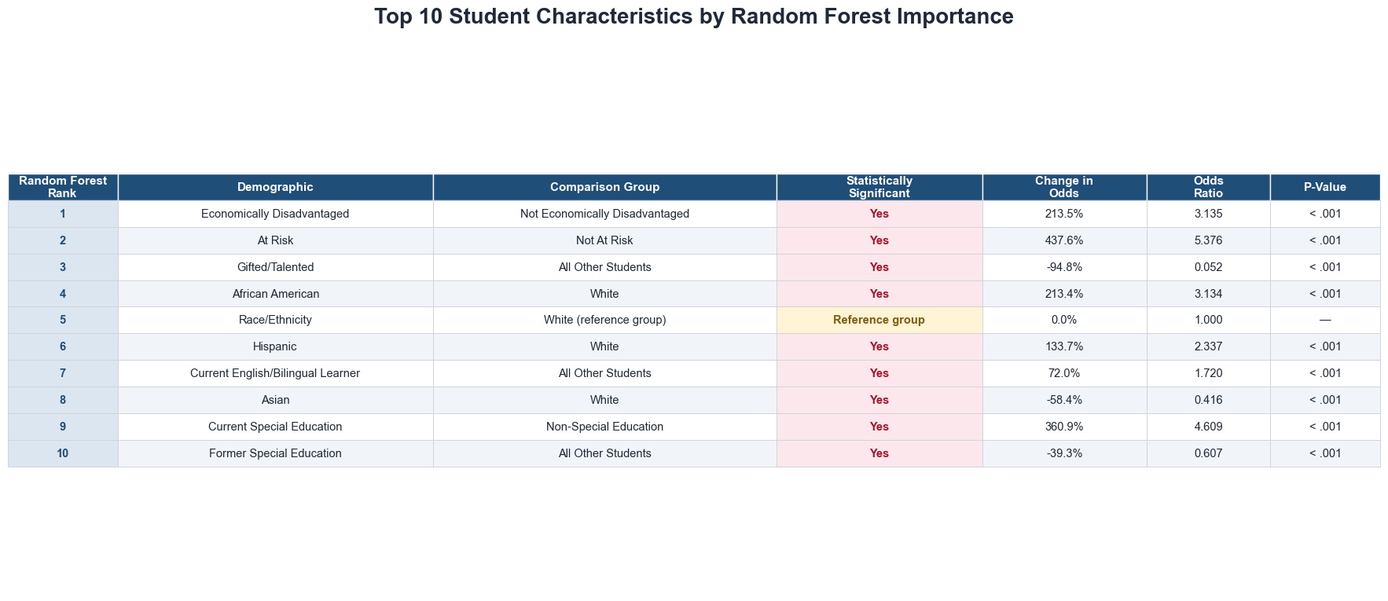
Comparison of Random Forest Rankings and Logistic Regression Results
Masking imputation and moderate accuracy limit predictive results
Source: Author’s analysis of Texas Education Agency (2025) data.

Slide 25
Limitations of the Tools Used
Excel made files easier to inspect, but renaming increased possibility of human error
Excel also had inconsistent naming formats
Python automated cleaning, but variable-definition error could affect data, data frame scrolling was difficult for large data, and I had to convert campus identifying strings to numbers with leading zeros – it can’t directly convert all Excel data

Slide 26
Limitations of the Techniques Used
Binomial logistic regression estimated associations, not causation
Models did not account for students in multiple groups
TEA masking prevented small groups from being fully represented
Median imputation allowed masked records to remain in the random-forest analysis, but it may have reduced accuracy
Random forest ranked predictive usefulness but did not show direction, statistical significance or causation

Slide 27
Proposed Action – Schools and Districts
Review the academic supports available to groups with higher below-grade-level odds
Begin with at-risk and current special education students
Use the results to identify groups needing further review
Provide targeted academic support and monitor subgroup results over time

Slide 28
Proposed Action – Data Reporting
Recommend consistent group and comparison-group columns across all demographic categories
Provide both group and non-group counts
Reduce the need to calculate comparison groups by subtracting subgroup counts from all-student totals
Improve the consistency, reproducibility, and interpretation of future analyses

Slide 29
Expected Benefits
Helps schools identify staff to review groups with the strongest associations, including at-risk students at 5.38 times the odds and current special education students at 4.61 times the odds of below-grade-level results
Repeatable for multi-year analyses so rankings can show demographic groups that consistently appear as priorities for academic support
Allows schools to allocate resources to direct targeted support by grade, subject, and student group
For every 1,000 students tested in a subject, a 5-percentage-point reduction would represent approximately 50 fewer below-grade-level outcomes
Establishes a statewide baseline across 4,965 campuses and 2.68 million assessment results
Creates a six-step annual process that can be repeated with future data and reduce workload in creating models

Slide 30
Thank you
Using statewide data to identify where targeted academic support may have the greatest impact
Please let me know if you have any questions

Slide 31
References
Brital, A. (2021, September 20). Random forest algorithm explained.
https://anasbrital98.github.io/blog/2021/Random-Forest/
National Center for Education Statistics. (n.d.). School geocodes & geoassignments. U.S.
Department of Education, Institute of Education Sciences. Retrieved August 22,
2026, from https://nces.ed.gov/programs/edge/geographic/schoollocations
Texas Education Agency. (2025). 2024–25 TAPR data download [Data set].
https://rptsvr1.tea.texas.gov/perfreport/tapr/tapr_dd_download.html?year=2025
Texas Education Agency. (2025). Explanation of 2024–25 TAPR masking rules.
https://rptsvr1.tea.texas.gov/perfreport/tapr/2025/masking.html

